Slide 1

Analyzing New York Stock Exchange

Slide 2
How Information Technology Research and Development Changed from the First to the Second Year?
These are two histogram representation of the first and second year
of R&D in Information Technology sector for all companies.
The histogram representations show that the R&D mean of the
second year is more than the R&D mean of the first year by more
than $100 million. That means companies start take Information
Technology more serious and invest more on the development of
this sector.
The mean for the R&D expenses of the first year is about $1.2 billion
and it is slightly increased in the second year to reach $1.3 billion.
However, the median for the second year is slightly less ($584
million) than the median for the first year ($590 million). The
standard deviation for the first year is $2.2 billion which is very
much higher than the mean value of the first year ($1.2 billion). That
tells the company R&D spending in the Information Technology is
scattered. Same thing happened in the second year where the
standard deviation was $2.4 billion and the mean was $1.3 billion.
The Range of first year was 10,611,000,000.00 compared to the rage of second year which was
11,537,000,000.00 which was higher .

Slide 3

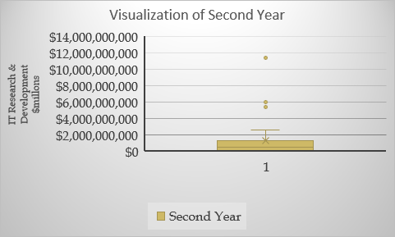
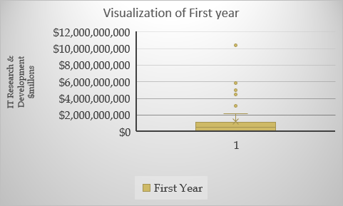
Visualization of First and Second Year

Slide 4
Analyzing New York Stock Exchange How Information Technology Research and Development Changed from the First to the Second Year?
These are two histogram representation of the first and second year
of R&D in Information Technology sector for all companies.
The histogram representations show that the R&D mean of the
second year is more than the R&D mean of the first year by more
than $100 million. That means companies start take Information
Technology more serious and invest more on the development of
this sector.
The mean for the R&D expenses of the first year is about $1.2 billion
and it is slightly increased in the second year to reach $1.3 billion.
However, the median for the second year is slightly less ($584
million) than the median for the first year ($590 million). The
standard deviation for the first year is $2.2 billion which is very
much higher than the mean value of the first year ($1.2 billion). The Range of first year was 10,611,000,000.00 compared to the rage of second year which was
11,537,000,000.00 which was higher .
That tells the company R&D spending in the Information Technology is
scattered. Same thing happened in the second year where the
standard deviation was $2.4 billion and the mean was $1.3 billion. Profit and Loss Statement of ABC Company Between First to Fourth Year
We can see from the below Profit & Loss Statement the gross profit increased remarkably during the four years.
The gross profit increased by $474 million in the second year which is 18.92% of the first year. The third year saw an
increase of gross profit by 18.33% of the previous year. The fourth year registered the highest gross profit of all the
years with 21.06% growth of the previous year.
The Operation Profit of the ABC company was not stable throughout the years. The Operating Profit registered $898

Slide 5
million in the first year. But went down to $782 million in the second year which is less that the first year by $116 million.
The third year registered even worst Operating Profit of $422 million which is almost half the operating profit of the
previous year. Things changed in the fourth year, with more than $1.5 billion Operating Profit which is three times the
Operating Profit of the previous year. Profit and Loss Statement Forecast of ABBV Company for the Next Two
Years
The forecast of the Profit & Loss Statement of the next two years for ABBV company show increase of revenue growth,
gross margin & operating margin. The revenue growth is expected to increase in the 5th and 6th year by 8% & 9% in the
best case scenario. But in the base case scenario the revenue growth is expected to increase by 7% & 8% in the 5th &
6th years. While in the weak case scenario the revenue growth is expected to increase by 6% & 7% in the 5th & 6th
years.
The gross margin is expected to increase in the 5th and 6th year by 78% & 79% in the best case scenario. But in the base
case scenario the gross margin is expected to increase by 77% & 78% in the 5th & 6th years. While in the weak case
scenario the revenue growth is expected to increase by 76% & 77% in the 5th & 6th years.
The operating margin is expected to increase in the 5th and 6th year by 30% & 31% in the best case scenario. But in the
base case scenario the operating margin is expected to increase by 29% & 30% in the 5th & 6th years. While in the weak
case scenario the operating margin is expected to increase by 28% & 29% in the 5th & 6th years.Thank you.. Santosh singh

Slide 6
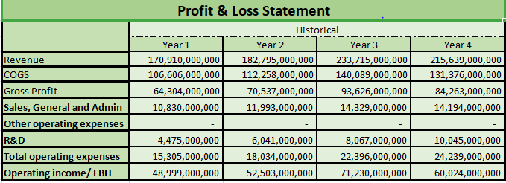
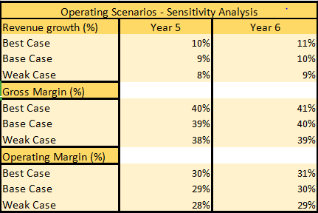
P

Slide 7
Profit and Loss Statement Forecast of AAPL Company for the Next Two Years
The forecast of the Profit & Loss Statement of the next two years for ABBV company show increase of revenue growth,
gross margin & operating margin. The revenue growth is expected to increase in the 5th and 6th year by 10% & 9% in the
best case scenario. But in the base case scenario the revenue growth is expected to increase by 10% & 11% in the 5th &
6th years. While in the weak case scenario the revenue growth is expected to increase by 8 % & 9% in the 5th & 6th
years.
The gross margin is expected to increase in the 5th and 6th year by 40% & 41% in the best case scenario. But in the base
case scenario the gross margin is expected to increase by 39% & 40% in the 5th & 6th years. While in the weak case
scenario the revenue growth is expected to increase by 38% & 39% in the 5th & 6th years.
The operating margin is expected to increase in the 5th and 6th year by 30% & 31% in the best case scenario. But in the
base case scenario the operating margin is expected to increase by 29% & 30% in the 5th & 6th years. While in the weak
case scenario the operating margin is expected to increase by 28% & 29% in the 5th & 6th years.Thank you..
Santosh Singh …

Slide 8
Thank You

